Slide 1
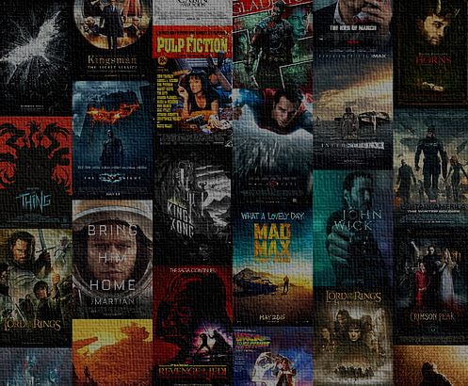

Movie parental guide predictive profiling from raw movie script using AI for automated viewability classification
By Sukesh

Slide 2
Contents
1
Problem Statement & Data Procurement
2
EDA Report and Insights
3
Data Cleaning and Preparation
4
Feature Engineering
5
Model Development and Results
6
Pre-Existing Model Research and Comparsion
7
References

Slide 3
1
Problem Statement & Data Procurement

Slide 4

Problem Overview
Current Business Problem
Entertainment industry is one of the fastest growing industries in the current age of globalization where content is no longer restricted to regional or language boundaries.
Though there are many positive sides to the growth there few negative implications as well of which one of the major concerns is the influence of Movies on audience, especially children.
Manual approach for rating a movie may seem accurate but it severely suffers from standardization as it can sometime be opinion driven (those there are certain guidelines for rating generation).
Government regulatory bodies like Classification & Ratings Administration (CARA)[1] by Motion Picture Association of America (MPAA)[2], in USA, regulates the content by provided appropriate classification of Parental Guide for Movies aired in USA. The rating provided by these agencies are generally based on potential violence, drug usage, and nudity etc., where a committee of 2-3 people manually watch a movie and provide ratings based on their observation.
Our Solution
In order to address this problem of slow, manual and subjective approach we are proposing a AI driven solution where a deep learning model can be trained to predict intensity of critical factors like violence, foul language, drug/alcohol usage etc., from movie script, which can later be used to provide overall rating for movie view-ability for children. In the current solution proposed we will be rating a movie on the following dimensions sex, violence, profanity, drugs and intense

Slide 5
Data Procurement and Source Details
Movies Metadata
Movies Scripts
Source: Kaggle.com
Source Description: Following is the source description as per Wiki “Kaggle, a subsidiary of Google LLC, is an online community of data scientists and machine learning practitioners. Kaggle allows users to find and publish data sets, explore and build models”
Method Procurement: Direct Download
Data Context:
Data contains selected movies from IMDB along with parental guide information scrapped from web. Data captures other metadata of the movie like Title, Start Year, Run Time etc.,
Source Link: https://www.kaggle.com/datasets/barryhaworth/imdb-parental-guide
Source: IMSDB.com
Source Description: Internet Movie Script Database (IMSDB) website has large collection of movie scripts in HTML format. Which allows users to read and download scripts with no cost.
Method Procurement: Web Scrapping
Data Context:
Data scrapped contains movie scripts in the HTML format. Script can be linked to corresponding metadata using movie title (the id which is used to scrape scripts)
Source Link: https://imsdb.com/

Slide 6


Scraping Movie Script from Internet
Movie tile name from metadata is searched for in imsdb using following link https://imsdb.com/script/<movie tile>
Availability of the movie in IMSDB can be take care using try except block
In case if movie is available script information is extract from the HTML tags
Extracted movie scripts are processed for removing unwanted HTML tags
756 movies scripts have been finally scrapped from IMSDB
Funnel Chart Showing Extraction of Scripts from Metadata till Final Number of Scripts
Extracting Movie Script info
Processing Extracted Script
Yes
39,124
Searching movie title in IMDBS
Title Found?
# of Movies in Metadata
Start
Stop
# Movie Scrapped (from IMSDB)
932
No
# of Valid Scripts (Exc. Blanks)
896
Stop
896
# Script for Model Building

Slide 7
Scraping Movie Script from Internet
Movie tile name from metadata is searched for in imsdb using following link https://imsdb.com/script/<movie tile>
Availability of the movie in IMSDB can be take care using try except block
In case if movie is available script information is extract from the HTML tags
Extracted movie scripts are processed for removing unwanted HTML tags
756 movies scripts have been finally scrapped from IMSDB
Extracting Movie Script info
Processing Extracted Script
Yes
39,124
Searching movie title in IMDBS
Title Found?
# of Movies in Metadata
Start
Stop
# Movie Scrapped (from IMSDB)
932
No
# of Valid Scripts (Exc. Blanks)
896
Stop
896
# Script for Model Building

Slide 8
Scraping Movie Script from Internet
Movie tile name from metadata is searched for in imsdb using following link https://imsdb.com/script/<movie tile>
Availability of the movie in IMSDB can be take care using try except block
In case if movie is available script information is extract from the HTML tags
Extracted movie scripts are processed for removing unwanted HTML tags
756 movies scripts have been finally scrapped from IMSDB
Extracting Movie Script info
Processing Extracted Script
Yes
Searching movie title in IMDBS
Title Found?
Start
Stop
No
Stop

Slide 9
2
EDA Report and Insights

Slide 10
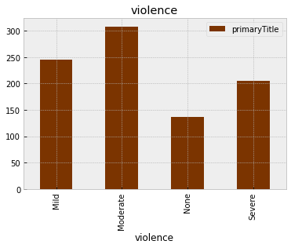
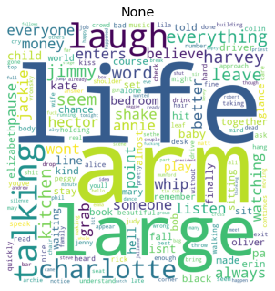
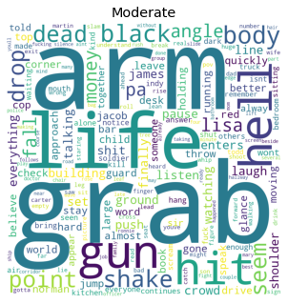
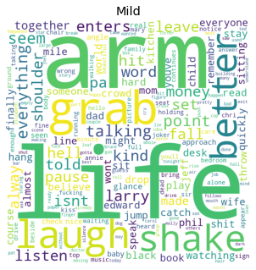
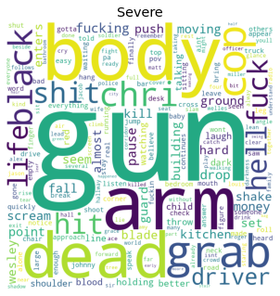
Understanding Parental Guide Ratings - Violence
Observations
Violence has a good distribution of scripts across all four classes
Density of the words showing violence like police station, machine gun, shooting etc., is increasing as we move from violence “None” to “Severe” – Bigram Analysis
Word Cloud
Bi-Gram Distributions

Slide 11
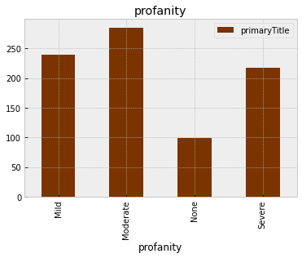
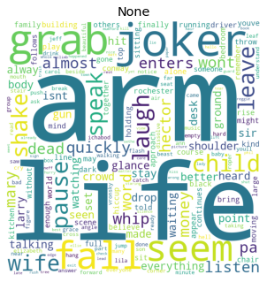
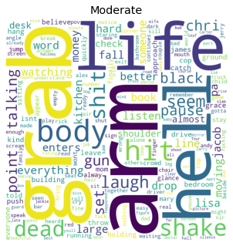
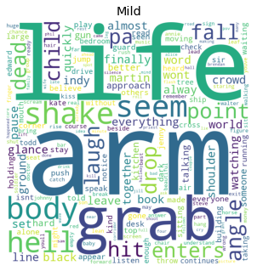
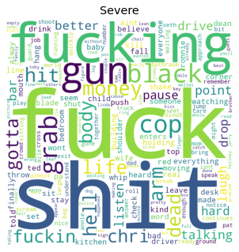
Understanding Parental Guide Ratings - Profanity
Observations
Profanity has a good distribution of scripts across all four classes (Profanity category “None” has relatively lower number of scripts)
Profanity category “None” has no or very less words conveying profanity while category “Severe” has words like f**k, S**t etc., - Observation from Word Cloud
Word Cloud
Bi-Gram Distributions

Slide 12
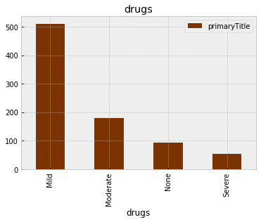
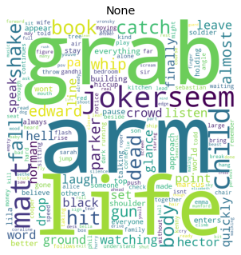
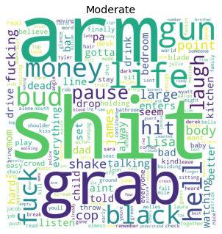
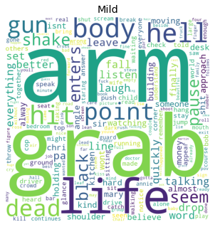
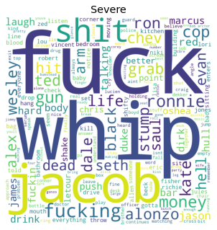
Understanding Parental Guide Ratings - Drugs
Observations
Number of scripts/movies is decreasing as we move from drugs used in the movie from “Mild” to “Severe” and “Mild” category has majority of scripts
This might make classification between “Moderate” and “Severe” a bit difficult due to lower class size
Profanity category “None” has no or very less words conveying profanity while category “Severe” has words like f**k, S**t etc., - Observation from Word Cloud
Word Cloud
Bi-Gram Distributions

Slide 13
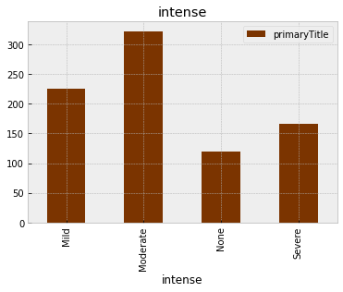
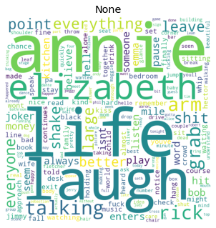
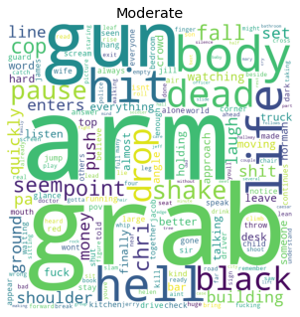
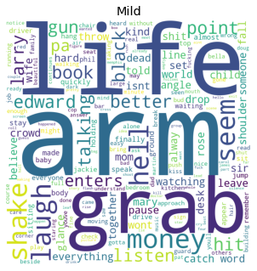
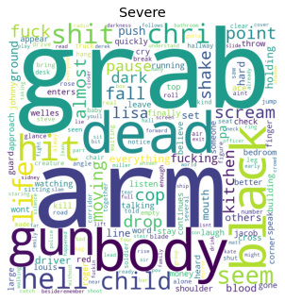
Understanding Parental Guide Ratings - Intense
Observations
Intenseness has a good distribution of scripts across all four classes
Intenseness at a high level has similar word distribution as that of violence
Word Cloud
Bi-Gram Distributions

Slide 14
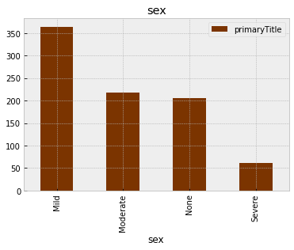
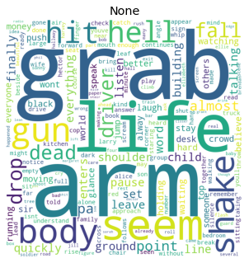
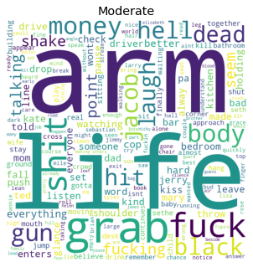
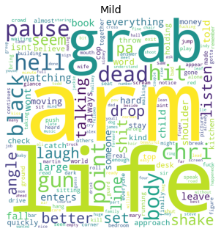
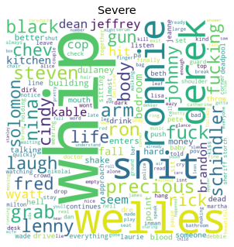
Understanding Parental Guide Ratings - Sex
Observations
Category SEX has a good distribution of scripts across all four classes (Sex category “None” has relatively lower number of scripts)
Word Cloud
Bi-Gram Distributions

Slide 15
EDA Conclusions
Observations
All the five movie parental guide classifications (Violence, Profanity, Intense, Drugs and Sex) has good distribution of scripts across four ratings
Classification of Drugs consumption in movies is a bit exception here as number of scripts/movies is decreasing as we move from drugs used in the movie from “Mild” to “Severe” and “Mild” category has majority of scripts. This might need class balancing for “Moderate” and “Severe” ratings if expected accuracy is not observed
Word distribution/density is change from rating “None” to “Severe” which is a good sign as it helps in easy separation of classes
As lot key words seems to be overlapping between classes its better to use TF-IDF vectors for model train instead of word frequencies

Slide 16
3
Data Cleaning and Preparation

Slide 17
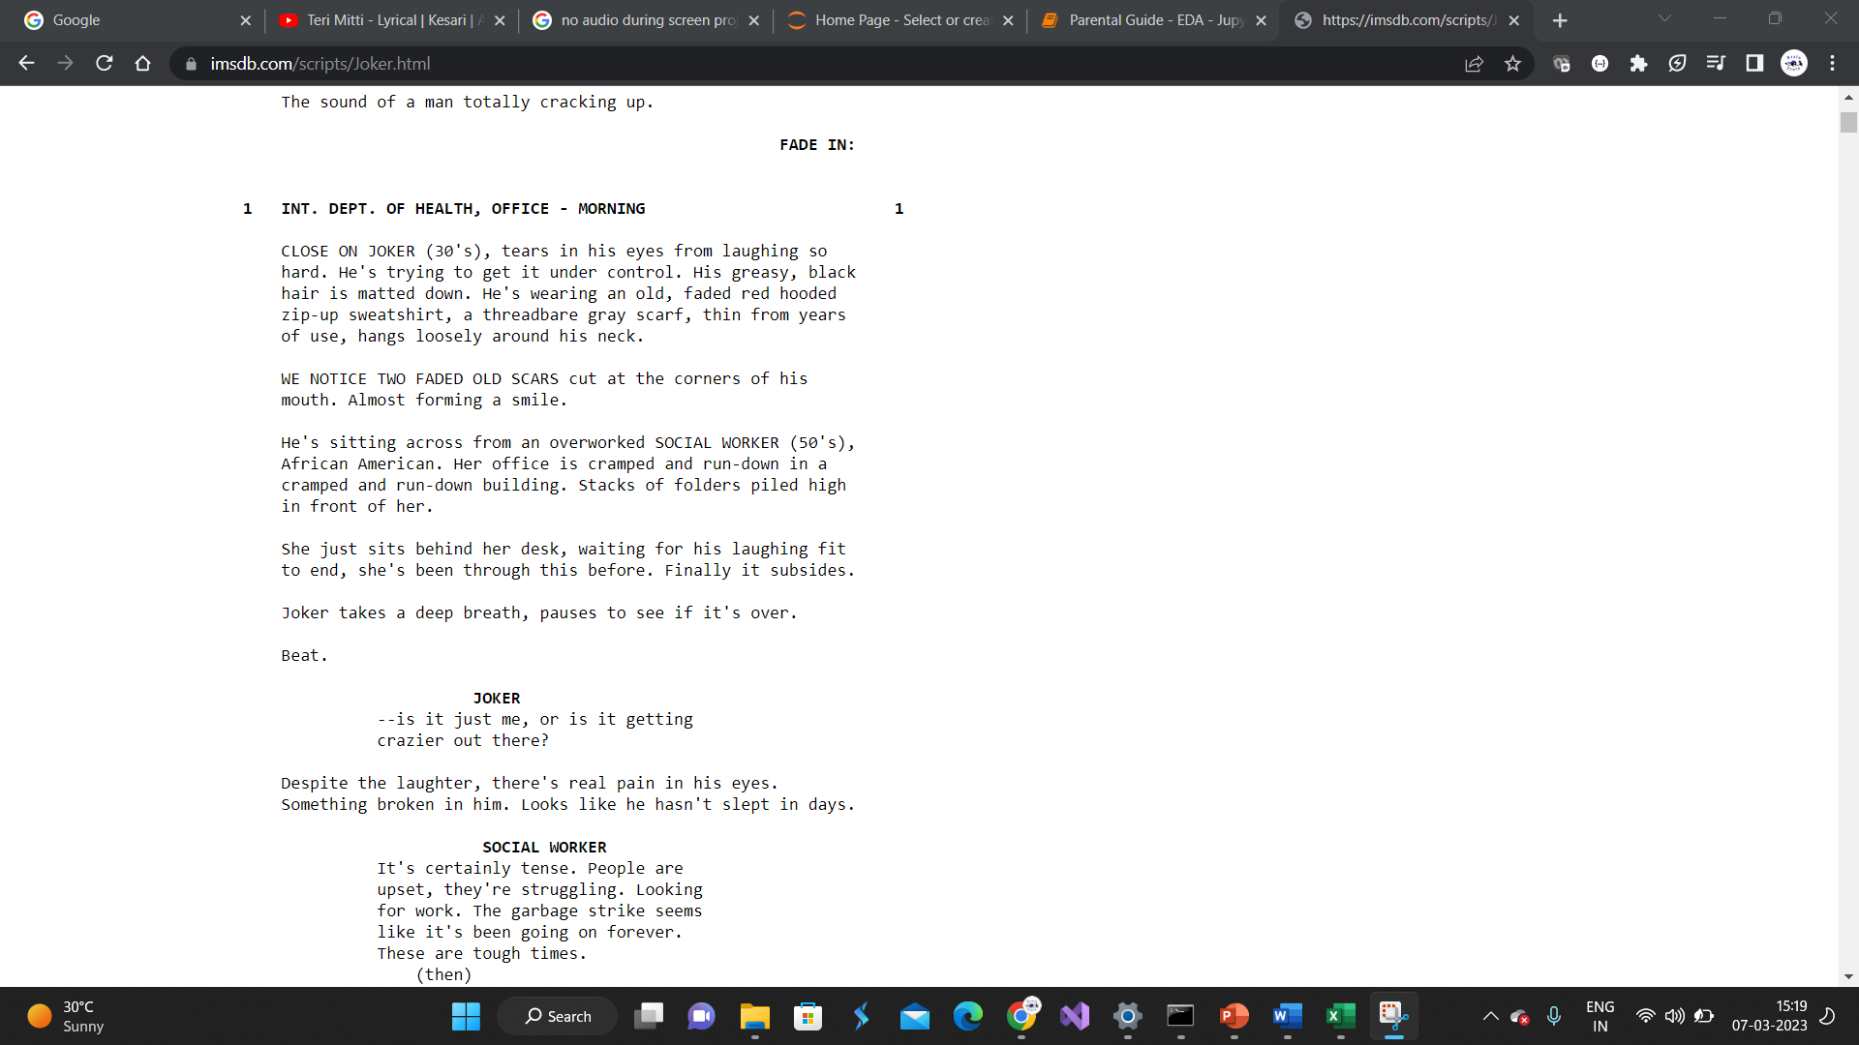
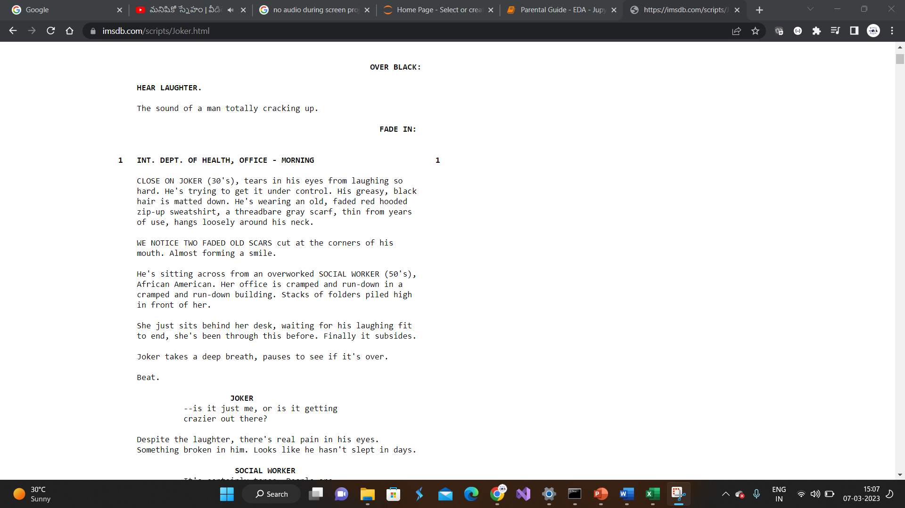
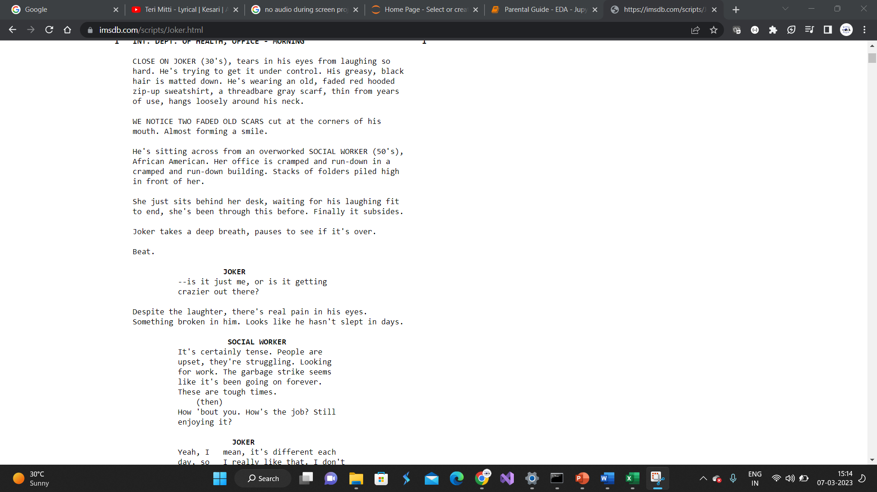
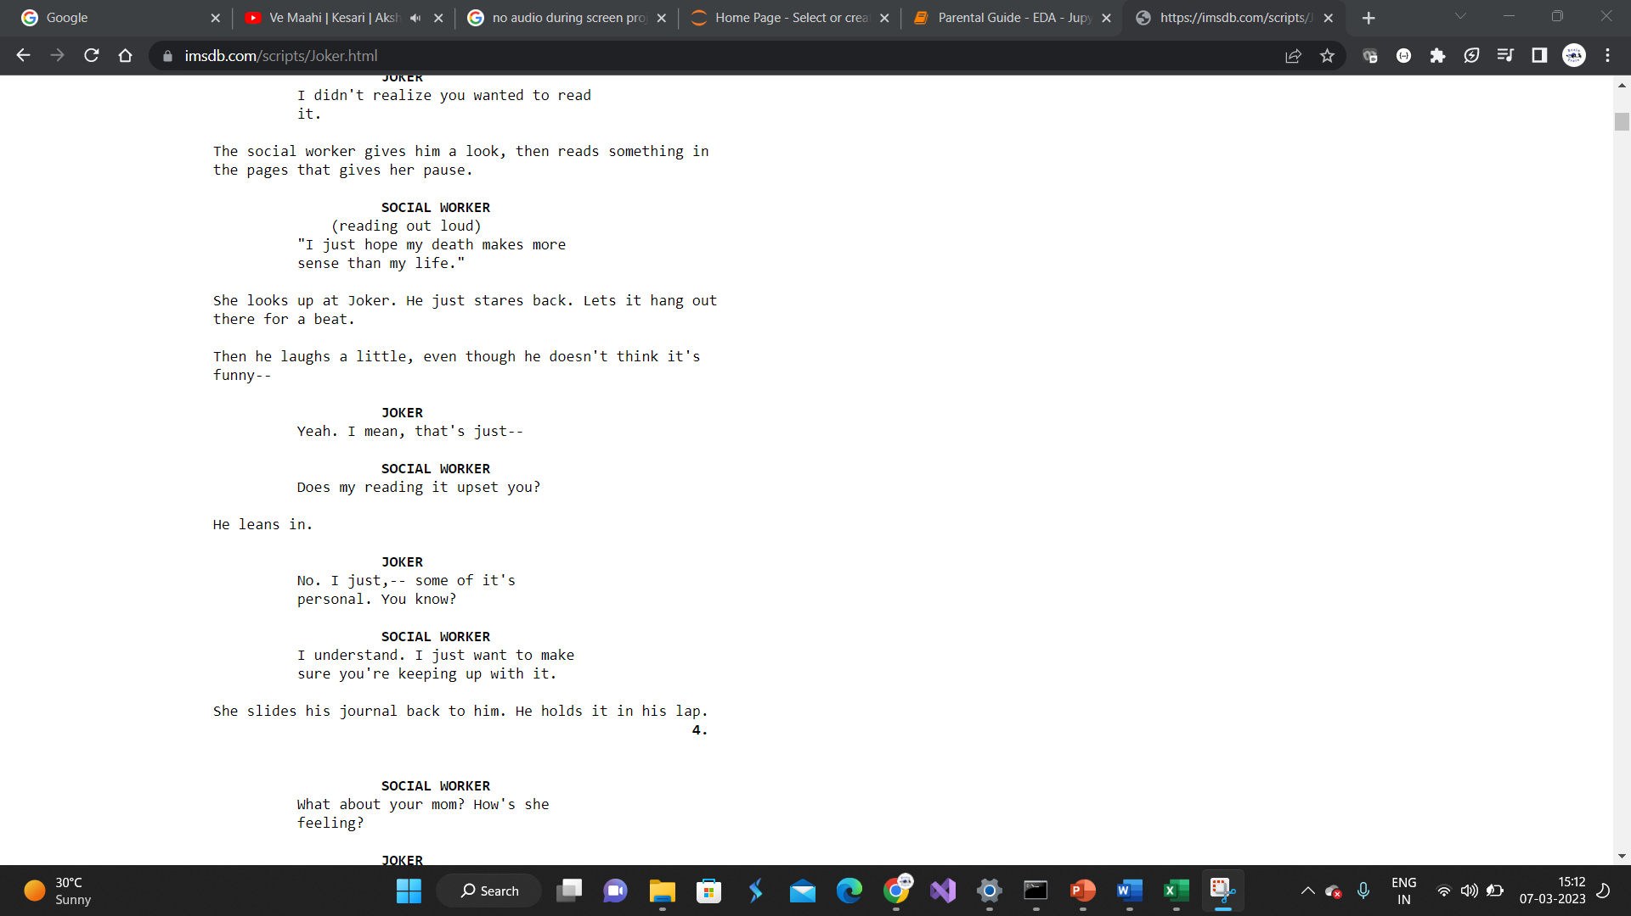
Data Cleaning
Step 1: Text Normalization
Text Normalization:
Text normalization is the process of converting text with mixed cases (lower/upper) cases to eighter lower or upper case
Text normalization helps in make data richer by treating the words with cases as one. For example the words “Script” and “script” have same meaning but are in different cases
Step 2: Stopwords and Special Character removal
Stop words and special character removal:
Words like “I”, “am”, “is”, “are” etc., are generally useful for making sentences grammatically correct but doesn't carry any information hence these can be excluded before modelling
Step3: Root word Extraction
Root word extraction:
Words like “script” and “scripted” convey same meaning with base word being “work”. Hence word like “scripted” can be converted to root word for building better generalized models
Root word extraction technique lemmatization has been used in the current work

Slide 18
Data Cleaning
Step 4: High Frequency Word Exclusion
High Frequency Word Exclusion:
Words like “look”, “day” etc., are not part of stopwords and they do not carry any major information which can help in movie rating profiling and hence can be excluded post manual inspection
Sample Frequent words from Script:
Step 5: Character Names and Script Related Tags Exclusion
Character Names and Script Related Tags Exclusion:
Words like “I”, “am”, “is”, “are” etc., are generally useful for making sentences grammatically correct but doesn't carry any information hence these can be excluded before modelling

Slide 19
4
Feature Engineering

Slide 20
Feature Engineering
Count vectorization has been used for converting text to word vectors
Other forms of word vector creation like TD-TDF etc., are not used as we are using advanced neural networds (RNN)
Tokenizer and texts_to_sequences functionality from Keras library has been used for word vector creation which then are used for feeding into RNNs
Same feature engineering steps have been performed on both test and train datasets

Slide 21
5
Initial Model Development and Results

Slide 22
Violence Prediction – Parameter Tuning & Bias Analysis
Summary
Multiple RNN models have been developed on movies script for violence prediction
10% of the total scripts are used as test data while rest 90% is used for model training
Multiple iteration performed by changing depth of neural nets, embedding length and number of epochs
Initially number of embedding and depth have be selected by keeping epochs constant, post selecting embedding and depth best performing model is iterated by changing epochs
Train accuracy of the model for Violence prediction is increasing with increase in number of epochs while test accuracy is decreasing after 8th epoch
So far model with 8 epochs has shown best train and test accuracy at overall level
Train accuracy: ~52%
Test accuracy: ~41%
Embedding Size: 128
Epochs: 08

Slide 23
Violence Prediction – Final Model Results, Cost & Loss Metrics
Summary
Model performance on Violence prediction is moderate with Test and Train accuracy of 52% and 41% respectively
Current best model iteration is doing good job for classifying “mild” and “severe” rating (good precision and recall observed) but failing in predicting “moderate” and “none” during train phase
Though model performance has been exceptional in predicting “mild” ratings during training phase but failed a bit in testing phase
Class “None” has zero predictions during Train and Test phases this can be due to relatively lower number of scripts with rating “None”
Average Model Run Time:
Final Model Loss Value: (Cross Entr.)
30 Sec
1.05
Train Confusion Matrix and Other Model Validation Parameters:
Test Confusion Matrix and Other Model Validation Parameters:
 |  | Predicted
 |  | mild | moderate | none | severe
Actual | mild | 157 | 29 | 0 | 38
 | moderate | 13 | 163 | 0 | 8
 | none | 13 | 113 | 0 | 1
 | severe | 13 | 14 | 0 | 244
 |  | Predicted
 |  | mild | moderate | none | severe
Actual | mild | 10 | 9 | 0 | 3
 | moderate | 5 | 11 | 0 | 5
 | none | 3 | 5 | 0 | 2
 | severe | 12 | 7 | 0 | 18
 | Precision | Recall
mild | 80% | 70%
moderate | 51% | 89%
none | - | 0%
severe | 84% | 90%
 | Precision | Recall
mild | 5% | 45%
moderate | 34% | 52%
none | - | 0%
severe | 64% | 49%
Overall Accuracy:
52%
Overall Accuracy:
41%

Slide 24

Profanity Prediction – Parameter Tuning & Bias Analysis
Summary
Multiple RNN models have been developed on movies script for profanity prediction
20% of the total scripts are used as test data while rest 80% is used for model training
Multiple iteration performed by changing depth of neural nets, embedding length, number of epochs, activation function and optimizer
Initially number of embedding and depth have be selected by keeping epochs constant, post selecting embedding and depth best performing model is iterated by changing epochs
Balanced and best train/test accuracy is obtained for model with 1RNN layer (25Units) and 1 Hidden layer (50Units)
Final model iteration selected has a train accuracy of 76% and test accuracy of 40%. Though this model has 35% variation (suggesting overfitting) between train and test accuracy, this has been selected as final model due to best test accuracy

Slide 25
Profanity Prediction – Final Model Results, Cost & Loss Metrics
Summary
Model performance on Profanity prediction is moderate with Test and Train accuracy of 40% and 76% respectively
Difference in train and test accuracy of ~35% is suggesting overfitting which not being addressed by modelling technique to low size of dataset
Majority of the scripts in test dataset are being classified as severe, high recall rate (73%) and low precision rate (36%) further confirms this
Overall model for Profanity prediction is showing similar results to that of Violence prediction with test accuracy of 40%
Average Model Run Time:
Final Model Loss Value: (Cross Entr.)
28 Sec
0.5
Train Confusion Matrix and Other Model Validation Parameters:
Test Confusion Matrix and Other Model Validation Parameters:
 |  | Predicted
 |  | mild | moderate | none | severe
Actual | mild | 186 | 0 | 3 | 9
 | moderate | 5 | 163 | 0 | 11
 | none | 4 | 9 | 68 | 35
 | severe | 44 | 4 | 2 | 173
 |  | Predicted
 |  | mild | moderate | none | severe
Actual | mild | 12 | 0 | 5 | 25
 | moderate | 4 | 6 | 1 | 28
 | None | 4 | 1 | 6 | 26
 | Severe | 9 | 6 | 2 | 45
 | Precision | Recall
mild | 94% | 78%
moderate | 91% | 93%
none | 59% | 93%
severe | 78% | 76%
 | Precision | Recall
mild | 41% | 29%
moderate | 46% | 15%
none | 43% | 16%
severe | 36% | 73%
Overall Accuracy:
76%
Overall Accuracy:
40%

Slide 26
Intense Prediction – Parameter Tuning & Bias Analysis
Summary
Multiple RNN models have been developed on movies script for profanity prediction
20% of the total scripts are used as test data while rest 80% is used for model training
Multiple iteration performed by changing depth of neural nets, embedding length, number of epochs, activation function and optimizer
Initially number of embedding and depth have be selected by keeping epochs constant, post selecting embedding and depth best performing model is iterated by changing epochs
Balanced and best train/test accuracy is obtained for model with 1RNN layer (25Units) and 1 Hidden layer (50Units)
Final model iteration selected has a train accuracy of 62% and test accuracy of 44%. Though this model has 18% variation (suggesting very minor overfitting) between train and test accuracy, this has been selected as final model due to best test accuracy

Slide 27
Intense Prediction – Final Model Results, Cost & Loss Metrics
Summary
Model performance on Intense prediction is moderate with Test and Train accuracy of 44% and 62% respectively
Difference in train and test accuracy of ~18% is suggesting mild overfitting which not being addressed by modelling technique to low size of dataset
Majority of the scripts in test dataset are being classified as severe or moderate (observation from precision rate)
Category “None” has excellent performance in train but has recall rate of only 22% in test
Overall model for Intense classification performing well than that of Profanity & Violence prediction
Average Model Run Time:
Final Model Loss Value: (Cross Entr.)
30 Sec
0.5
Train Confusion Matrix and Other Model Validation Parameters:
Test Confusion Matrix and Other Model Validation Parameters:
 |  | Predicted
 |  | mild | moderate | none | severe
Actual | mild | 98 | 9 | 0 | 51
 | moderate | 3 | 90 | 0 | 24
 | none | 10 | 43 | 28 | 46
 | severe | 10 | 11 | 0 | 204
 |  | Predicted
 |  | mild | moderate | none | severe
Actual | mild | 31 | 6 | 1 | 30
 | moderate | 2 | 42 | 0 | 6
 | None | 6 | 13 | 12 | 23
 | Severe | 6 | 7 | 0 | 84
 | Precision | Recall
mild | 81% | 62%
moderate | 59% | 77%
none | 100% | 100%
severe | 63% | 91%
 | Precision | Recall
mild | 69% | 46%
moderate | 62% | 84%
none | 92% | 22%
severe | 59% | 87%
Overall Accuracy:
62%
Overall Accuracy:
44%

Slide 28
Sex Prediction – Parameter Tuning & Bias Analysis
Summary
Multiple RNN models have been developed on movies script for profanity prediction
20% of the total scripts are used as test data while rest 80% is used for model training
Multiple iteration performed by changing depth of neural nets, embedding length, number of epochs, activation function and optimizer
Initially number of embedding and depth have be selected by keeping epochs constant, post selecting embedding and depth best performing model is iterated by changing epochs
Balanced and best train/test accuracy is obtained for model with 1RNN layer (25Units) and 2 Hidden layer (50Units, 10UNits)
Final model iteration selected has a train accuracy of 85% and test accuracy of 41%. Though this model has 30% variation (suggesting overfitting) between train and test accuracy, this has been selected as final model due to best test accuracy

Slide 29
Sex Prediction – Final Model Results, Cost & Loss Metrics
Summary
Model performance on Intense prediction is moderate with Test and Train accuracy of 41% and 85% respectively
Difference in train and test accuracy of ~18% is suggesting mild overfitting which not being addressed by modelling technique to low size of dataset
Majority of the scripts in test dataset are being classified as severe or moderate (observation from precision rate)
Category “None” has excellent performance in train but has recall rate of only 22% in test
Overall model for Intense classification performing well than that of Profanity & Violence prediction
Average Model Run Time:
Final Model Loss Value: (Cross Entr.)
30 Sec
0.5
Train Confusion Matrix and Other Model Validation Parameters:
Test Confusion Matrix and Other Model Validation Parameters:
 |  | Predicted
 |  | mild | moderate | none | severe
Actual | mild | 284 | 0 | 6 | 7
 | moderate | 6 | 0 | 8 | 36
 | none | 64 | 0 | 122 | 10
 | severe | 51 | 0 | 7 | 115
 |  | Predicted
 |  | mild | moderate | none | severe
Actual | mild | 35 | 0 | 4 | 28
 | moderate | 7 | 0 | 3 | 2
 | None | 31 | 0 | 16 | 10
 | Severe | 23 | 0 | 8 | 13
 | Precision | Recall
mild | 70% | 96%
moderate | - | 0%
none | 85% | 62%
severe | 68% | 66%
 | Precision | Recall
mild | 36% | 52%
moderate | - | 0%
none | 52% | 28%
severe | 25% | 30%
Overall Accuracy:
85%
Overall Accuracy:
41%

Slide 30
6
Pre-Existing Model Research and Comparsion

Slide 31
Pre-Existing Model Research and Comparison
“Age Suitability Rating: Predicting the MPAA Rating Based on Movie Dialogues” by Mahsa Shafaei, Niloofar Safi Samghabadi [1] and “Machine Learning Models for Content Classification in Film Censorship and Rating” by Syma Afsha are few of the paper discuss the use of Movie Subtitle/Dialogues/Scripts for classifying movie ratings. Afore mentioned papers describes the use of both Machine Learning and Deep Learning techniques one of the paper saw 81.6% but doesn’t give specific detail if the reported F1 score is for test of train dataset
Our approach for rating classification across different segments is consistently giving us more than ~80% accuracy on train dataset and ~40% accuracy on test dataset. We suspect that the low test accuracy is due
Low data volume
Number of classes for predictions
As we are building a multiclass classification problem where we see very thin barrier from one class to other leading to higher error. Overall our model is doing good job in profiling scripting except for classifying a scripts with “None” rating, which is due to relatively few number of scripts with class “None”.

Slide 32
7
References

Slide 33
References
Observations
Movie parental guide review process in USA
[1] https://www.healthychildren.org/English/family-life/Media/Pages/TV-Ratings-A-Guide-for-Parents.aspx
[2] https://www.theschoolrun.com/parents-guide-movie-age-ratings
[3] https://www.carafilmratings.com/
Text Pre-processing (Data Cleaning, Traditional Steps)
[4] https://web.stanford.edu/~jurafsky/slp3/ed3book.pdf
Feature Engineering (Word Vector Creation)
[5] https://machinelearningmastery.com/what-are-word-embeddings/
[6] https://www.analyticsvidhya.com/blog/2020/02/quick-introduction-bag-of-words-bow-tf-idf/
RNN model development using Keras and Tensorflow
[7] https://www.tensorflow.org/guide/keras/rnn

Slide 34
Thank You

